Slide 1
Chapter 2
Raster Scan Graphics
Ms.Dudhmale M.N.

Slide 2
INTRODUCTION
Scan conversion is a general form for drawing methods, which create raster images according to picture primitives.
The term is mainly used for drawing methods for 2D picture elements or primitives such as lines, polygons and text.
The process to determine which pixel provides the best approximation to shape the object is called as rasterization, and when such procedure is combined with picture generation using scan line is called as Scan Conversion.
Scan conversion of any object requires scan conversion of lines and curves.

Slide 3
Digital Differential Analyzer Algorithm
1: Input the coordinates of the two end points A(x_{1,}y₁) & B(x₂,y₂) for the line AB respectively.
2: Calculate dx=x₂-x₁ & dy=y₂-y₁
3: Calculate the length L
if abs(x₂-x₁) >= abs(y₂-y₁) then
L=abs(x₂-x₁)
else
L=abs(y₂-y₁)

Slide 4
4: Calculate the incremental factor
dx=(x2-x1)/L & dy=(y2-y1)/L
5: Initialize the initial point on the line & plot
x_{new} = x₁ + 0.5 * (sign ∆x) &
y_{new =} y₁ + 0.5 * (sign ∆x)
//The values are rounded using the factor of 0.5 rather than truncating so that the central pixel addressing is handled correctly.//
6: [Obtain the new pixel on the line & plot the same]
Initialize i =1

Slide 5
While(i<=L)
{
x_{new}=x_{new} + ∆x
y_{new} = y_{new} + ∆ y
plot(Integer x_{new} , Integer y_{new})
i=i+1
}
7: Finish

Slide 6
Advantages :
Simple & fast
Does not require special skills for implementing it in any programming language.
Disadvantage:
Though this method is fast ,accumulation of rounding off errors may drift the pixel away from the actual pixels.

Slide 7
Exercise
Consider the line from (0,0) to (4,6). Use DDA to rasterizing this line.
Consider line from (4,4) to (7,9). Use DDA to rasterizing this line

Slide 8
Bresenham’s Line Drawing Algorithm
The Bresenham’s algorithm uses only integer addition, subtraction and multiplication by 2
And we know that computer can perform integer addition and subtraction very rapidly.
The computer is also time efficient when performing integer multiplication by 2.
The basic principle of Bresenham’s algorithm is to select the optimum raster locations to represent a straight line.

Slide 9
Bresenham’s Line Drawing Algorithm
To accomplish this the algorithm always increments either x or y by one unit depending upon the slope of the line.
The increment in other variable is determined by examining the distance between the actual line location and the nearest pixel.
This distance is called decision variable or error.
The error term is initially set as e=2*∆y- ∆x.
Let us study the algorithm now:

Slide 10
Algorithm:
Read the coordinates of the two end points (x_{1,}y₁) & (x₂,y₂) such that they are not equal.(if equal then plot that point and exit)
∆x=│x2-x1│ and ∆y=│y2-y1│.
Initialize the starting point i.e x=x1 and y=y1.
Calculate e= 2∆y-∆x
Initialize i=1.
Plot(x,y)

Slide 11
7. While(e≥0)
{
y=y+1
e=e-2*∆x
}
x=x+1
e=e+2*∆y
8. i=i+1
9. if(i≤∆x) then go to step 6.
10. Stop.

Slide 12
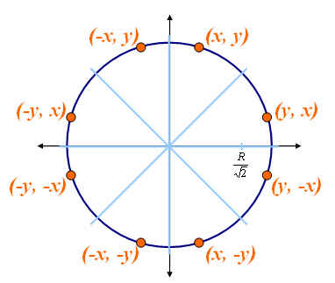
Basic Concepts in Circle Drawing
Circle is a symmetrical figure.
The shape of the circle is similar in each quadrant
It has eight-way symmetry
Plot (x,y) Plot (-x,y)
Plot (y,x) Plot (y, -x)
Plot (-x,-y) Plot (x,-y)
Plot (-y,-x) Plot (-y,x)

Slide 13
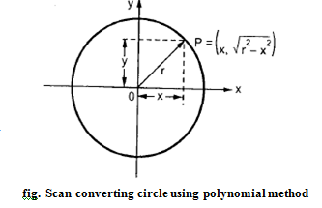
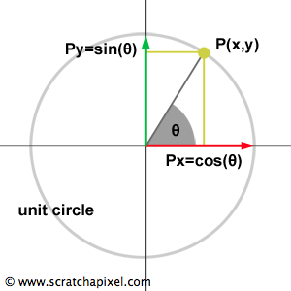
Representation of Circle
Polynomial Method
x2 + y2 = r2
Trigonometric Method
x= r cos Ө
Y = r sin Ө

Slide 14
Bresenham’s Circle drawing Algorithm:
The Bresenham’s circle drawing algorithm considers the eight way of the symmetry of the circle to generate it.
It plots 1/8th part of the circle i.e. from 90ᵒ to 45ᵒ.
As circle is drawn from 90ᵒ to 45ᵒ,the x moves in x direction and y moves in the negative direction.

Slide 15
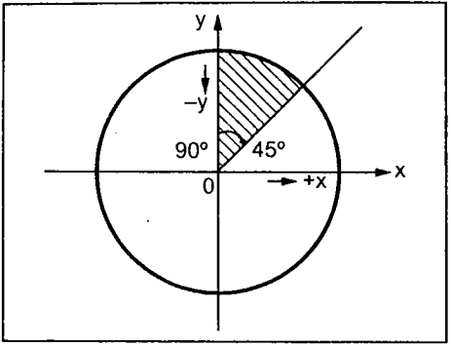
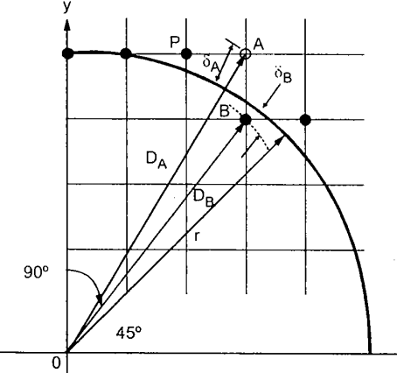
Bresenham’s Circle drawing Algorithm:

Slide 16



Distance of pixel A and B from origin
Now, the distances of pixel A and B from true circle are
To avoid square root term

Slide 17
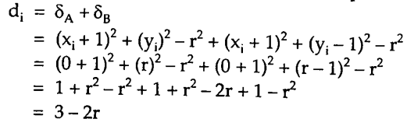
We find that δ_{A} is always positive and δ_{B} is always negative. Therefore we define decision variable d_{i}
d_{i} = δ_{A} + δ_{B}
If δA < δB (d_{i} < 0) then only x is incremented, otherwise x is incremented and y is decremented.
Equation for di at starting point x=0, y=r

Slide 18
Algorithm to plot 1/8 of the circle:
Read the radius (r) of the circle.
Initialize the decision variable. d=3-2r
Initialize the starting point x=0 and y=r.
Do
{
plot(x,y)
if(d<0) then {
d=d+4x+6
}

Slide 19
else {
d=d+4(x-y)+10
y=y-1
}
x=x+1
}while(x<y)
5. Stop.

Slide 20
Polygon
Polyline is a chain of connected line segments. It is specified by giving the vertices P₀, P₁, P₂..and so on.
The first vertex is called initial point and last is called terminal point.
P₃
P₄
P₆
P1
P₀
P₂
P₅

Slide 21
Cont…..
When initial point and terminal point of any polyline is same (when polyline is closed) then it is called polygon.

Slide 22
Types of Polygon
1. Convex polygon is a polygon in which the line segment joining any two points within the polygon lies completely inside the polygon

Slide 23
Cont…
2. Concave polygon is a polygon in which the line segment joining any two points within the polygon may not lie completely inside the polygon.

Slide 24
Polygon Filling
Types of filling
Solid-fill
All the pixels inside the polygon’s boundary are illuminated.
Pattern-fill
the polygon is filled with an arbitrary predefined pattern.

Slide 25
Polygon Representation
For objects described by many polygons with many vertices, this can be a time consuming process.
One method for reducing the computational time is to represent the polygon by the (absolute) location of its first vertex, and represent subsequent vertices as relative positions from the previous vertex. This enables us to translate the polygon simply by changing the coordinates of the first vertex.

Slide 26
Inside-Outside Tests
when filling polygons we should decide whether a particular point is interior or exterior to a polygon.
A rule called the odd-parity (or the odd-even rule) is applied to test whether a point is interior or not.
To apply this rule, we conceptually draw a line starting from the particular point and extending to a distance point outside the coordinate extends of the object in any direction such that no polygon vertex intersects with the line.

Slide 27
Inside-Outside Tests
The point is considered to be interior if the number of intersections between the line and the polygon edges is odd. Otherwise, The point is exterior point.
Outside
8
7
6
5
4
3
2
1
0
0
1
2
3
4
5
6
7
8
9
10
11
Inside

Slide 28
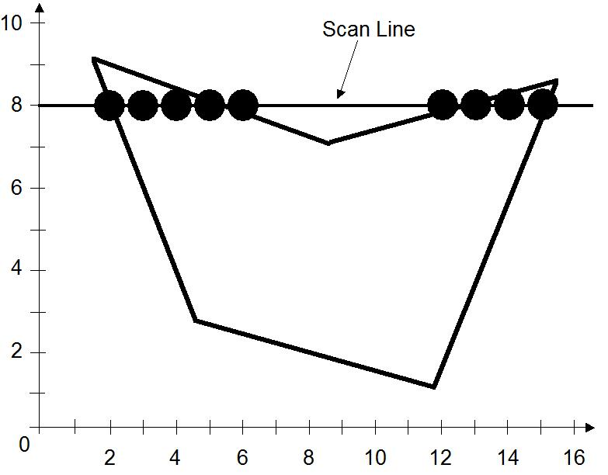
The Scan-Line Polygon Fill Algorithm
The scan-line polygon-filling algorithm involves
the horizontal scanning of the polygon from its lowermost to its topmost vertex,
identifying which edges intersect the scan-line,
and finally drawing the interior horizontal lines with the specified fill color. process.

Slide 29
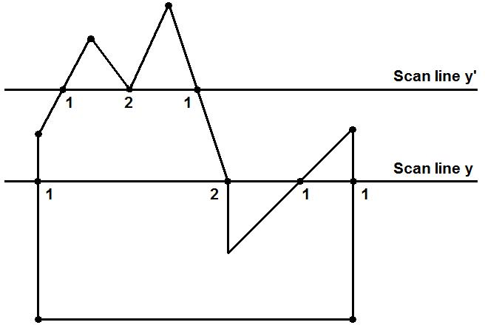
The Scan-Line Polygon Fill Algorithm
Dealing with vertices

Slide 30
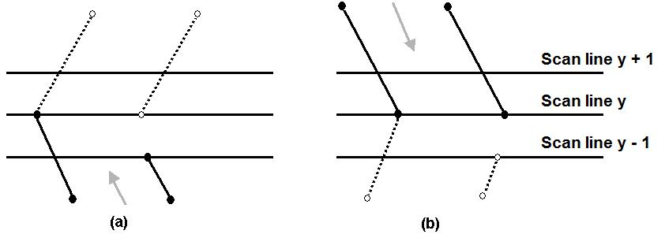
The Scan-Line Polygon Fill Algorithm
Dealing with vertices
When the endpoint y coordinates of the two edges are increasing, the y value of the upper endpoint for the current edge is decreased by one (a)
When the endpoint y values are decreasing, the y value of the next edge is decreased by one (b)

Slide 31
Algorithm
Read n, number of vertices of polygon
Read x and y coordinates of all vertices in array x[n] and y[n]
Find y_{min} and y_{max.}
Store the initial x value (x1) y values y1 and y2 for two endpoints and

Slide 32
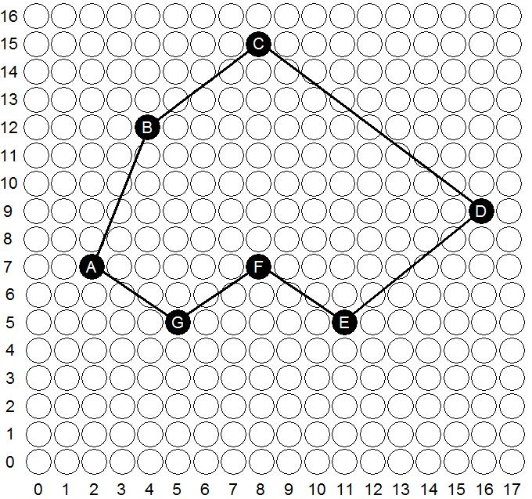
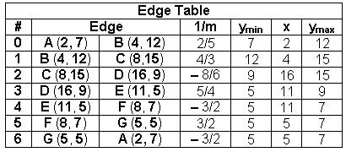
The Scan-Line Polygon Fill Algorithm
(Example) Polygon = {A, B, C, D, E, F, G}
Polygon = {(2, 7), (4, 12), (8,15), (16, 9), (11, 5), (8, 7), (5, 5)}

Slide 33
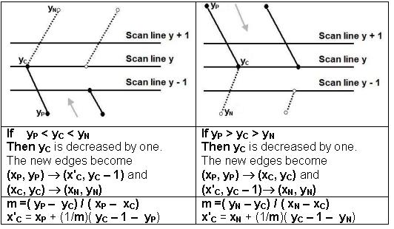
The Scan-Line Polygon Fill Algorithm
(Example)

Slide 34
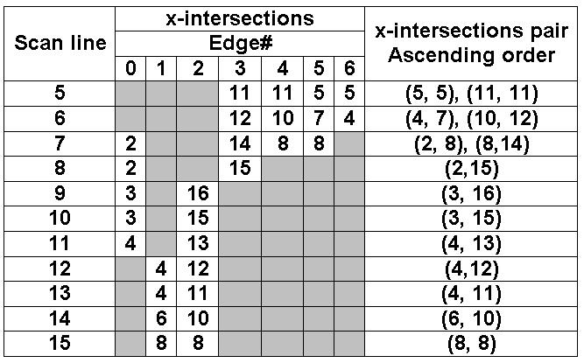
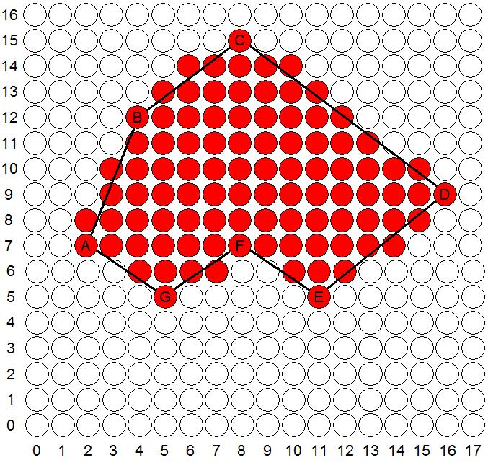
The Scan-Line Polygon Fill Algorithm
(Example)

Slide 35
Boundary Fill Algorithm
Another approach to area filling is to start at a point inside a region and paint the interior outward toward the boundary.
If the boundary is specified in a single color, the fill algorithm processed outward pixel by pixel until the boundary color is encountered.
A boundary-fill procedure accepts as input the coordinate of the interior point (x, y), a fill color, and a boundary color.

Slide 36
Boundary Fill Algorithm
The following steps illustrate the idea of the recursive boundary-fill algorithm:
1. Start from an interior point.
2. If the current pixel is not already filled and if it is not an edge point, then set the pixel with the fill color, and store its neighboring pixels (4 or 8-connected) in the stack for processing. Store only neighboring pixel that is not already filled and is not an edge point.
3. Select the next pixel from the stack, and continue with step 2.

Slide 37
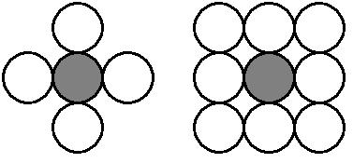
Boundary Fill Algorithm
The order of pixels that should be added to stack using 4-connected is above, below, left, and right. For 8-connected is above, below, left, right, above-left, above-right, below-left, and below-right.

Slide 38
Boundary Fill Algorithm
4-connected (Example)
Start Position

Slide 39
Boundary Fill Algorithm
4-connected (Example)
3
2
1
1
2
3

Slide 40
Boundary Fill Algorithm
4-connected (Example)
4
2
1
1
4
2

Slide 41
Boundary Fill Algorithm
4-connected (Example)
2
1
1
2

Slide 42
Boundary Fill Algorithm
4-connected (Example)
5
1
5
1

Slide 43
Boundary Fill Algorithm
4-connected (Example)
1
1

Slide 44
Boundary Fill Algorithm
4-connected (Example)

Slide 45
Boundary Fill Algorithm
8-connected (Example)
Start Position

Slide 46
Boundary Fill Algorithm
8-connected (Example)
5
4
3
2
1
4
1
5
2
3

Slide 47
Boundary Fill Algorithm
8-connected (Example)
6
4
3
2
1
6
4
1
2
3

Slide 48
Boundary Fill Algorithm
8-connected (Example)
8
7
4
3
2
1
7
8
4
1
2
3

Slide 49
Boundary Fill Algorithm
8-connected (Example)
12
11
10
9
7
4
3
2
1
11
9
12
7
10
4
1
2
3

Slide 50
Boundary Fill Algorithm
8-connected (Example)
11
10
9
7
4
3
2
1
11
9
7
10
4
1
2
3

Slide 51
Boundary Fill Algorithm
8-connected (Example)
10
9
7
4
3
2
1
9
7
10
4
1
2
3

Slide 52
Boundary Fill Algorithm
8-connected (Example)
9
7
4
3
2
1
9
7
4
1
2
3

Slide 53
Boundary Fill Algorithm
8-connected (Example)
7
4
3
2
1
7
4
1
2
3

Slide 54
Boundary Fill Algorithm
8-connected (Example)
4
3
2
1
4
1
2
3

Slide 55
Boundary Fill Algorithm
8-connected (Example)
3
2
1
1
2
3

Slide 56
Boundary Fill Algorithm
8-connected (Example)
2
1
1
2

Slide 57
Boundary Fill Algorithm
8-connected (Example)
1
1

Slide 58
Boundary Fill Algorithm
8-connected (Example)

Slide 59
Boundary Fill Algorithm
These methods (Span Flood-Fill) fill horizontal pixel spans across scan lines, instead of proceeding to 4-connected or 8-connected neighboring pixels.
Then we need only stack a beginning position for each horizontal pixel spans, instead of stacking all unprocessed neighboring positions around the current position.

Slide 60
Span Flood-Fill Algorithm
The algorithm is summarized as follows:
Starting from the initial interior pixel, then fill in the contiguous span of pixels on this starting scan line.
Then locate and stack starting positions for spans on the adjacent scan lines, where spans are defined as the contiguous horizontal string of positions bounded by pixels displayed in the area border color.
At each subsequent step, unstack the next start position and repeat the process.

Slide 61
Span Flood-Fill Algorithm (example)
11
10
9
8
7
6
5
S
4
3
2
1
0
0
1
2
3
4
5
6
7
8
9
10
11
12
13
14

Slide 62
Span Flood-Fill Algorithm (example)
11
10
9
8
2
1
7
6
2
5
S
4
1
3
2
1
0
0
1
2
3
4
5
6
7
8
9
10
11
12
13
14

Slide 63
Span Flood-Fill Algorithm (example)
11
10
9
8
3
1
7
3
6
2
5
S
4
1
3
2
1
0
0
1
2
3
4
5
6
7
8
9
10
11
12
13
14

Slide 64
Span Flood-Fill Algorithm (example)
11
10
9
8
5
6
6
5
4
1
7
3
6
4
2
5
S
4
1
3
2
1
0
0
1
2
3
4
5
6
7
8
9
10
11
12
13
14

Slide 65
Span Flood-Fill Algorithm (example)
11
10
9
7
8
5
6
7
5
4
1
7
3
6
4
2
5
S
4
1
3
2
1
0
0
1
2
3
4
5
6
7
8
9
10
11
12
13
14

Slide 66
Span Flood-Fill Algorithm (example)
11
10
9
7
8
5
6
5
4
1
7
3
6
4
2
5
S
4
1
3
2
1
0
0
1
2
3
4
5
6
7
8
9
10
11
12
13
14

Slide 67
Span Flood-Fill Algorithm (example)
11
10
9
8
7
8
5
6
8
4
1
7
3
6
4
2
5
S
4
1
3
2
1
0
0
1
2
3
4
5
6
7
8
9
10
11
12
13
14

Slide 68
Span Flood-Fill Algorithm (example)
11
10
9
8
7
8
5
6
4
1
7
3
6
4
2
5
S
4
1
3
2
1
0
0
1
2
3
4
5
6
7
8
9
10
11
12
13
14

Slide 69
Span Flood-Fill Algorithm (example)
11
10
9
8
7
8
5
6
9
1
7
3
6
4
2
5
9
S
4
1
3
2
1
0
0
1
2
3
4
5
6
7
8
9
10
11
12
13
14

Slide 70
Span Flood-Fill Algorithm (example)
11
10
9
8
7
8
5
6
10
1
7
3
6
4
2
5
9
S
4
10
1
3
2
1
0
0
1
2
3
4
5
6
7
8
9
10
11
12
13
14

Slide 71
Span Flood-Fill Algorithm (example)
11
10
9
8
7
8
5
6
11
1
7
3
6
4
2
5
9
S
4
10
1
3
11
2
1
0
0
1
2
3
4
5
6
7
8
9
10
11
12
13
14

Slide 72
Span Flood-Fill Algorithm (example)
11
10
9
8
7
8
5
6
12
1
7
3
6
4
2
5
9
S
4
10
1
3
11
2
12
1
0
0
1
2
3
4
5
6
7
8
9
10
11
12
13
14

Slide 73
Span Flood-Fill Algorithm (example)
11
10
9
8
7
8
5
6
1
7
3
6
4
2
5
9
S
4
10
1
3
11
2
12
1
0
0
1
2
3
4
5
6
7
8
9
10
11
12
13
14

Slide 74
Span Flood-Fill Algorithm (example)
11
10
9
8
7
8
5
6
7
3
6
4
2
5
9
S
4
10
1
3
11
2
12
1
0
0
1
2
3
4
5
6
7
8
9
10
11
12
13
14

Slide 75
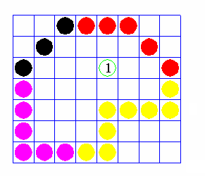
Flood Fill Algorithm
Sometimes we want to fill in (recolor) an area that is not defined within a single color boundary.
We paint such areas by replacing a specified interior color instead of searching for a boundary color value.
This approach is called a flood-fill algorithm.

Slide 76
Flood Fill Algorithm
We start from a specified interior pixel (x, y) and reassign all pixel values that are currently set to a given interior color with the desired fill color.
If the area has more than one interior color, we can first reassign pixel values so that all interior pixels have the same color.
Using either 4-connected or 8-connected approach, we then step through pixel positions until all interior pixels have been repainted.

Slide 77
Character Generation
Letters, numbers, and other character are often displayed to label and annotate drawing and go give instructions and information to the user.
Most of the times characters are built into the graphics display devices, usually as hardware but sometimes through software.
There are basic three methods:
Stroke method
Starburst method
Bitmap method

Slide 78
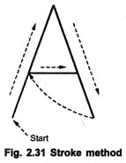
1. Stroke method
This method uses small line segments to generate a character.
The small series of line segments are drawn like a strokes of a pen to form a character as shown in figure.
We can build our own stroke method.
By calling a line drawing algorithm.

Slide 79
Cont…
Here it is necessary to decide which line segments are needed for each character and
Then drawing these segments using line drawing algorithm.
This method supports scaling of the character.
It does this by changing the length of the line segments used for character drawing.

Slide 80
Starburst method
In this method a fix pattern of line segments are used to generate characters.
As shown in figure, there are 24 line segments.
Out of 24 line segments, segments required to display for particular character, are highlighted
This method is called starburst method because of its characteristic appearance.

Slide 81
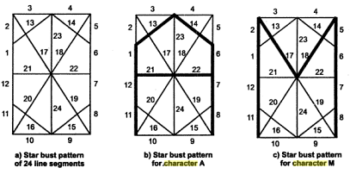
Fig shows the starburst patterns for character A and M.
The patterns for particular characters are stored in the form of 24 bits code.
Each bit representing one line segment.
The bit is set to one to highlight the line segment otherwise it is set to zero.
Character A : 0011 0000 0011 1100 1110 0001
Character M:0000 0011 0000 1100 1111 0011

Slide 82
Cont…
This method of character generation is not used now a days because of following disadvantages:
The 24-bits are required to represent a character. Hence more memory is required.
Requires code conversion software to display character from its 24 bits code.
Character quality poor. Worst for curve shaped character.

Slide 83
Bitmap Method
It is also known as dot matrix because in this method characters are represented by an array of dots in the matrix form.
It’s a two dimensional array having columns and rows : 5 X 7 as shown in figure.
7 X 9 and 9 X 13 arrays are also used.
Higher resolution devices may use character array 100 X 100.

Slide 84
Each dot in the matrix is a pixel.
The character is placed on the screen by copying pixel values from the character array into some position of the screen’s frame buffer.
Value of the pixel controls the intensity of the pixel.
Usually the dot patterns for all characters are stored in the hardware device called a character generation chip.

Slide 85
Cont,,,,
This chip accepts address for the character and gives the bit pattern for that character as an output.
Here the size of the pixel is fixed and hence the size of the dot.
Characters can be represented in many fonts.
When number of fonts are more, the bit patterns for characters may also be stored in RAM.
Antialiasing is possible in this method.

Slide 86
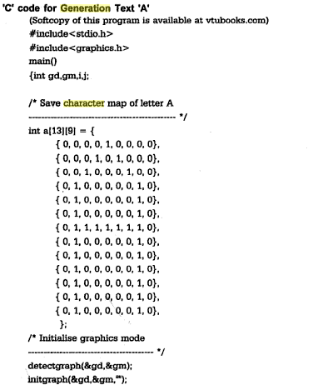
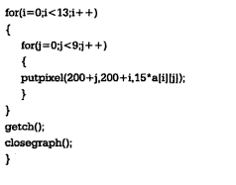
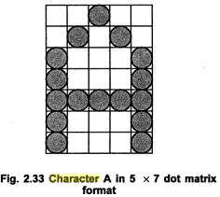

Slide 87
Question Bank
Following are 2 Marks questions
What is the basic requirement of any line drawing algorithm (R)
List the line drawing algorithm? (R)
Define/What is polygon? ( R )
List the type of polygon/ what are the types of polygon? (R )
List the polygon filling methods? (R )
What is polygon filling? ( R )
List the character generation methods? ( R)

Slide 88
Cont…
Question Bank
Following are 4 marks questions
Describe DDA line drawing algorithm……(U)
Explain Bresenham’s Line drawing algorithm…..(U)
Describe boundary fill method with diagram…….(U)
Derive the expression of bresenham’s circle drawing algorithm……..(A)
Explain inside outside test for polygon filling with example……..(U)

Slide 89
Question Bank
Consider the line from (0,0) to (4,6). Use DDA to rasterizing this line………………..(A)
Consider line from (4,4) to (7,9). Use DDA to rasterizing this line………….(A)
Consider the line from (1,1) to (5,6). Use DDA to rasterizing this line………………..(A)
Consider the line from (0,0) to (4,6). Use Bresenham’s line drawing algorithm to rasterizing this line……………(A)

Slide 90
Question Bank
Consider the line from (1,1) to (5,3). Use Bresenham’s line drawing algorithm to rasterizing this line……………(A)
Consider the line from (2,7) to (5,5). Use Bresenham’s line drawing algorithm to rasterizing this line……………(A)

